Slide 1
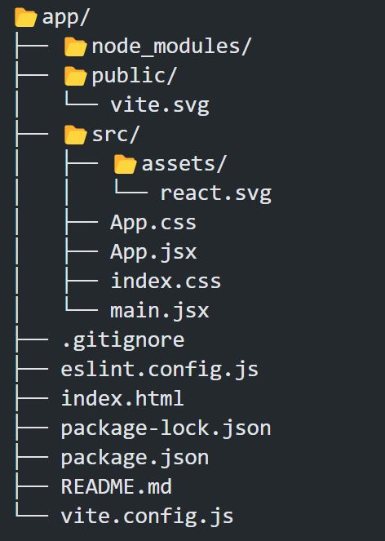
📂 Folder Structure

Slide 2
1. Node Modules 📂:
Purpose: This folder contains all the dependencies and packages your project needs.
Generated by: npm install
Tip: Don’t touch this manually; it’s auto-managed. It's excluded using .gitignore.
2. Public 📂:
Purpose: Contains static files that do not go through the Vite build process.
Example: vite.svg — a default logo provided by Vite.
Use Case: Place public assets like logos, favicon, etc. here.
Access: Use them with /vite.svg in your code.

Slide 3
3. Src 📂 (Source) :
This is the main folder where your React application lives.
Assets 📂: Stores images, logos, icons, etc.
App.jsx : This is the heart of your app, the main component. You write your app’s UI logic here. Used inside: main.jsx
App.css : Styles for App.jsx. Helps you separate logic and design.
index.css : Global styles for your whole application.
main.jsx : Entry point for React app. Renders App.jsx into the DOM.

Slide 4
4. .gitignore :
Purpose: Tells Git which files/folders to ignore (like node_modules, .env etc.)
5. eslint.config.js :
ESLint helps catch errors and enforce code style.
This config file defines rules and plugins.
6. index.html :
Main HTML file that Vite uses as a template.
Contains: <div id="root"></div> where React mounts.

Slide 5
7. package.json
Very important: It describes your project.
Contains:
Project name, version
Scripts (dev, build, etc.)
Dependencies
8. package-lock.json
Auto-generated by npm.
Locks exact versions of dependencies to ensure consistency.

Slide 6
9. README.md :
Markdown file for project description.
You can write instructions, tech used, and how to run the project.
10. vite.config.js
Configuration file for Vite.
Used to add plugins, change default settings like aliases, server ports, etc.

